Slide 1

Diploma Studies
Computer Engineering
Basic Computer Organization and Design
Unit – 2
Title - Basic Computer Organization and Design
Computer Organization (09CE2401)

Slide 2
What is Program
Program is a set of instructions for directing the computer to perform a required data-processing task.

Slide 3
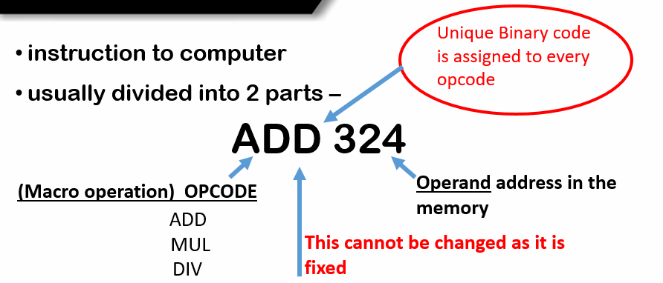
Instruction Code
Instruction Code:- is a group of bits that instructs computer to perform specific operation. (in binary)
Operations (opcode) such as addition, subtraction, shift, complement, etc.

Slide 4
Stored Program Organization
The simplest way to organize a computer is to have one processor register and an instruction code format with two parts.
The first part specifies the operation to be performed and the second specifies an address.
The memory address tells the control where to find an operand in memory.
This operand is read from memory and used as the data to be operated with the data stored in the processor register together.

Slide 5
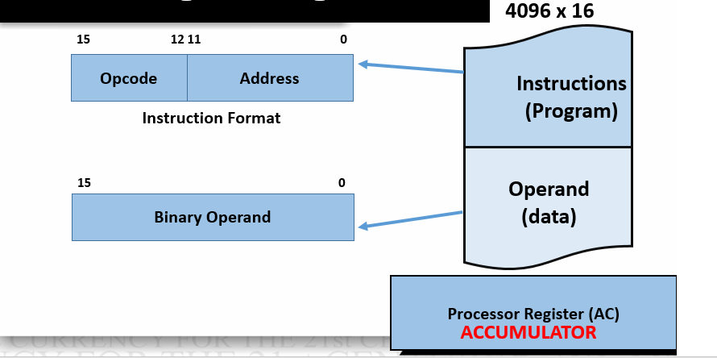
Stored Program Organization
Instructions are stored in one section of memory and while data in another.
For a memory unit with 4096 words we need 12 bits to specify an address since 2¹² = 4096.
Memory contains 4096 words of 16 bit each, to address 4096 location we will require 2^12 address.

Slide 6
Computer Instructions
Computer Instruction:-
Computer instructions are a set of machine language instructions that a particular processor understands and executes.
A computer performs tasks on the basis of the instruction provided.
An instruction comprises of groups called fields. These fields include:
The Mode field specifies how the operand will be located.
The Opcode field specifies the operation to be performed.
The Address field contains the location of the operand, i.e., register or memory location.

Slide 7
Computer Instructions
A basic computer has three instruction code formats which are:
Memory - reference instruction
Register - reference instruction
Input-Output instruction

Slide 8
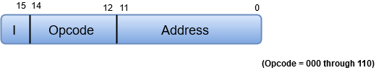
(1) Memory Reference Instruction
In Memory-reference instruction, 12 bits of memory is used to specify an address and one bit to specify the addressing mode 'I'.
If the value of I is 0, it means direct addressing and value of I is 1 indicates indirect addressing.
Opcode values are between 000 and 110 (i.e., 0-7).
0-6 represents different opcode

Slide 9

(2) Register Reference Instruction
These instructions perform operations on registers rather than memory addresses.
The IR(14 – 12) is 111 (differentiates it from memory reference) and IR(15) is 0 (differentiates it from input/output instructions).
The rest 12 bits specify register operation.

Slide 10
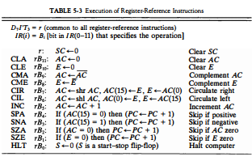
(2) Register Reference Instruction

Slide 11

(3) Input-Output instruction
These instructions are for communication between computer and outside environment.
The IR(14 – 12) is 111 (differentiates it from memory reference) and IR(15) is 1 (differentiates it from register reference instructions).
The rest 12 bits specify I/O operation.

Slide 12
Computer Instructions
Note:-
The three operation code bits in positions 12 through 14 should be equal to 111.
Otherwise, the instruction is a memory-reference type, and the bit in position 15 is taken as the addressing mode I.

Slide 13
Timing and Control
The timing for all registers in the basic computer is controlled by a master clock generator.
The clock pulses are applied to all flip-flops and registers in the system, including the flip-flops and registers in the control unit.

Slide 14
Timing and Control
The clock pulses do not change the state of a register unless the register is enabled by a control signal.
The control signals are generated in the control unit and provide control inputs for the multiplexers in the common bus, control inputs in processor registers, and micro-operations for the accumulator.

Slide 15
Design of Control Unit
The Control Unit is classified into two major categories:
Hardwired Control
Microprogrammed Control

Slide 16
Control Unit
Hardwired Control
The Hardwired Control organization involves the control logic to be implemented with gates, flip-flops, decoders, and other digital circuits.

Slide 17
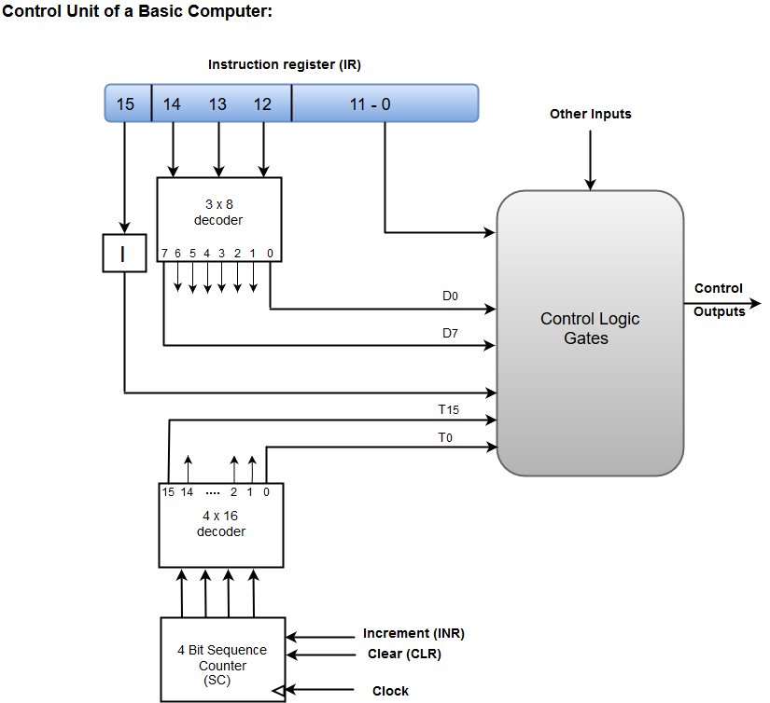
Control Unit – Hardwired Control

Slide 18
Control Unit – Hardwired Control
A Hard-wired Control consists of two decoders, a sequence counter, and a number of logic gates.
An instruction fetched from the memory unit is placed in the instruction register (IR).
The component of an instruction register includes; I bit, the opcode, and bits 0 through 11.
The opcode in bits 12 through 14 are coded with a 3 x 8 decoder.

Slide 19
Control Unit – Hardwired Control (Continue)
The outputs of the decoder are designated by the symbols D0 through D7.
The opcode at bit 15 is transferred to a flip-flop designated by the symbol I.
The opcodes from Bits 0 through 11 are applied to the control logic gates.
The Sequence counter (SC) can count in binary from 0 through 15.

Slide 20
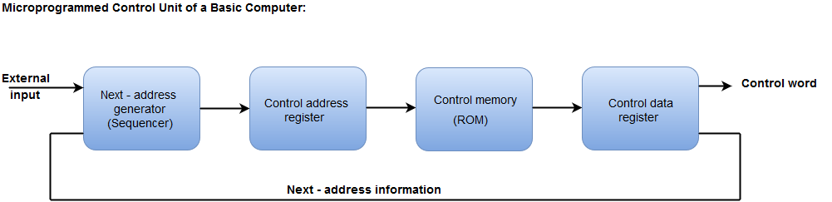
(2) Control Unit – Microprogrammed Control
The Microprogrammed Control organization is implemented by using the programming approach.
In Microprogrammed Control, the micro-operations are performed by executing a program consisting of micro-instructions.

Slide 21
(2) Control Unit – Microprogrammed Control
The Control address register specifies the address of the micro-instruction.
The Control memory is assumed to be a ROM, within which all control information is permanently stored.
The control data register holds the micro-instruction fetched from the memory.
The control word specifies one or more micro-operations for the data processor.

Slide 22
(2) Control Unit – Microprogrammed Control (Continue)
While the micro-operations are being executed, the next address is computed in the next address generator circuit and then transferred into the control address register to read the next microinstruction.
The next address generator is often referred to as a micro-program sequencer

Slide 23
Instruction Cycle
A program residing in the memory unit of a computer consists of a sequence of instructions.
These instructions are executed by the processor
1. Fetch instruction from memory
2. Decode the instruction
3. Read the effective address from memory if the instruction has an indirect address
4. Execute the instruction
After following four steps are done, the control switches back to the first step and repeats the similar process for the next instruction.
Therefore, the cycle continues until a Halt condition is met.

Slide 24
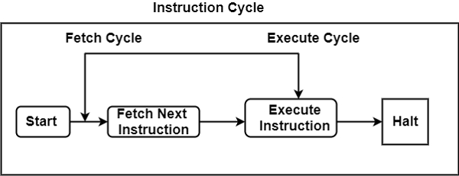
Instruction Cycle – Diagram

Slide 25
Instruction Cycle
(1) Fetch Cycle
The address instruction to be implemented is held at the program counter.
The processor fetches the instruction from the memory that is pointed by the PC.
Next, the PC is incremented to display the address of the next instruction.
This instruction is loaded into the instruction register.

Slide 26
Instruction Cycle
(2) Execute Cycle
The data transfer for implementation takes place in two methods are as follows −
(i) Processor-memory − The data sent from the processor to memory or from memory to processor.
(ii) Processor-Input/Output − The data can be transferred to or from a peripheral device by the transfer between a processor and an I/O device.

Slide 27
INTERRUPT

Slide 28
Interrupt
The interrupt is a signal emitted by hardware or software when a process needs immediate attention.
It alerts the processor to a high-priority process requiring interruption of the current working process.
In I/O devices one of the bus control lines is dedicated for this purpose and is called the Interrupt Service Routine (ISR).

Slide 29
Interrupt
When a device raises an interrupt at the process, the processor first completes the execution of an instruction.
Then it loads the Program Counter (PC) with the address of the first instruction of ISR.
Before loading the program counter with the address, the address of the interrupted instruction is moved to a temporary location.
Therefore, after handling the interrupt, the processor can continue with the process.

Slide 30
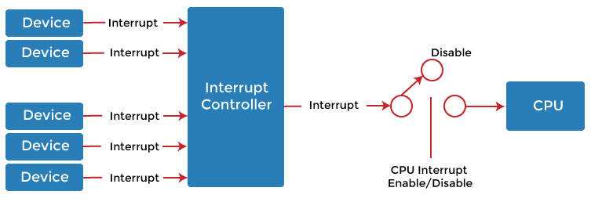
Interrupt

Slide 31
Types of Interrupt
There are two types of interrupts which are as follows :
Hardware Interrupt
Software Interrupt
INTERRUPT
HARDWARE INTERRUPT
SOFTWARE INTERRUPT
MASKABLE INTERRUPT
NON-MASKABLE INTERRUPT
NORMAL INTERRUPT
EXECPTION

Slide 32
Types of Interrupt
Hardware Interrupt:-
The interrupt signal generated from external devices and i/o devices are made interrupt to CPU when the instructions are ready.
For example- In a keyboard if we press a key to do some action, this pressing of the keyboard generates a signal that is given to the processor to do action,
such interrupts are called hardware interrupts.

Slide 33
Types of Interrupt
Hardware interrupts are classified into two types which are as follows −
(i) Maskable Interrupt − The hardware interrupts that can be delayed when a highest priority interrupt has occurred to the processor.
(ii) Non Maskable Interrupt − The hardware interrupt that cannot be delayed and immediately be serviced by the processor.

Slide 34
Types of Interrupt
(2) Software Interrupt:-
The interrupt signal generated from internal devices and software programs need to access any system call then software interrupts are present.
Software interrupt is divided into two types. They are as follows-
(i) Normal Interrupts- The interrupts that are caused by the software instructions are called normal interrupts.
(ii) Exception- Exception is nothing but an unplanned interruption while executing a program. For example − while executing a program if we got a value that is divided by zero is called an exception.

Slide 35
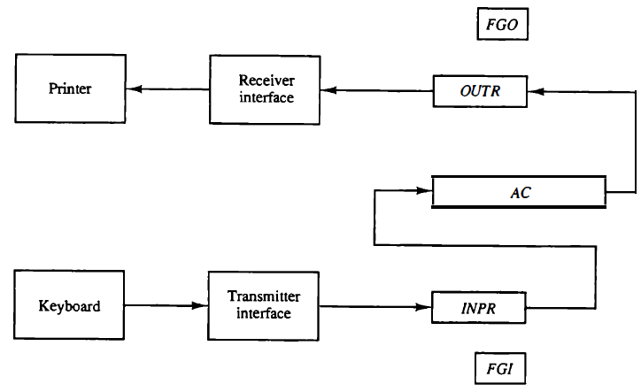
Input-Output Configuration
1 bit control flag
1 bit control flag

Slide 36
Input-Output Configuration
The figure displays an illustration of the input and output device.
The input device is the keyboard and the output device is the printer.
The terminals are the keyboard and printer.
They send and receive the data consecutively.
The data is alphanumeric and 8-bits in size.
The input supported by the keyboard is transfer to the input register INPR.
The information is saved in the OUTPR (output register) in the serial order for the printer.
The OUTR saves the serial data for the printer.

Slide 37
Input-Output Configuration
The I/O registers communicate serially with interfaces (keyboard, printer) and parallel with AC.
The sender interface receives data from the keyboard and transfers it to INPR.
The receiver interfaces access the data and address it to the printer.
The INPR holds the 8- bit alphanumeric input data.

Slide 38
Input-Output Configuration
FGI defines a 1-bit input flag which is a flip-flop.
When the input device receives any new information, the flip flop is set to 1.
It is cleared to 0 when information is received through the output device.
The output device sets the FGO to 1 after receiving, decoding, and printing the information.
FGO in the 0 modes denotes that the device is printing information.

Slide 39
(1) Memory Reference Instruction
D₀ = 000 (AND OPERATION)
Example:- AND to AC
D₀ T₄: DR <- M[AR]
D₀ T₅: AC <- AC ^ DR, SC <- 0
D₁ = 001 (ADD OPERATION)
Example:- ADD to AC
D₁ T₄: DR <- M[AR]
D₁ T₅: AC <- AC + DR, SC <- 0
E <- Count
E = contains Carry, called Extended Accumulator
AC = Accumulator
DR = Data Register
AR = Address Register
SC = Sequence Counter

Slide 40
(1) Memory Reference Instruction
D₂ = 010 (LOAD OPERATION)
Example:- LDA to AC
D₂ T₄: DR <- M[AR]
D₂ T₅: AC <- DR, SC <- 0
D₃ = 011 (STORE OPERATION)
Example:- STA to AC
D₃ T₄: M[AR] <- AC, SC <- 0

Slide 41
(1) Memory Reference Instruction
D₄ = 100 (Branch Unconditionally)
Example:- Branch Unconditionally
D₄ T₄: PC <- AR, SC <- 0
D₅ = 101 (Branch & Save Return Address)
Example:- BSA
D₅ T₄: M[AR] <- PC, AR <- AR+1
D₅ T₄: PC <-AR, SC <- 0
D₆ = 110 (Increment & skip if zero)
Example:- ISZ
D₆ T₄: DR <- M[AR]
D₆ T₅: DR <- DR+1, M[AR] <- DR ,
if (DR=0), PC <- PC+1, SC <- 0

Slide 42


